Slide 1
Product Guide
CJV300 Series Cut and Print Models
September 2014

Slide 2
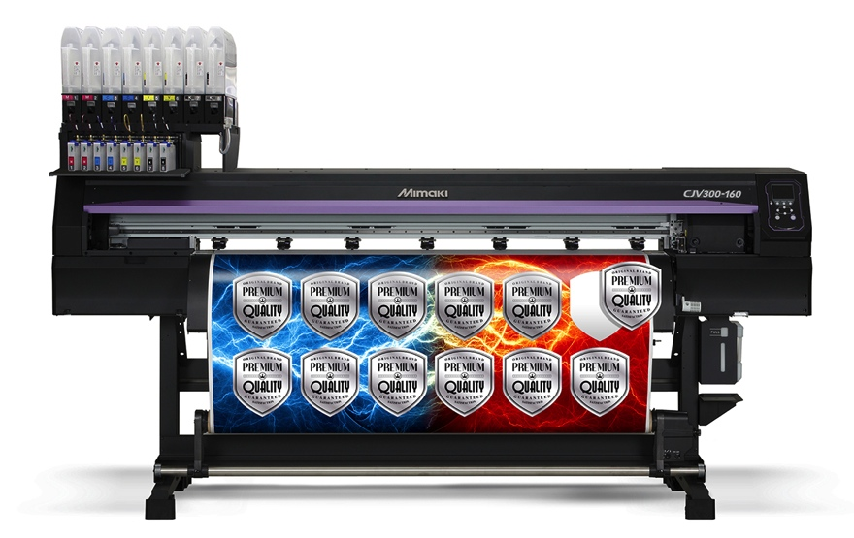
Contents
Key Features
Print Technologies
Ink Sets
Print Speeds
Cutting Functions
Additional Features
RasterLink6
Preparing for Installation
Notes:
This presentation will highlight key technologies and their roles in delivering outstanding image quality and reliable performance with many cost-saving features.

Slide 3
Key Features
Outstanding Speed
  Staggered dual-head design and high density drop size
    Delivers a wider swath for faster throughput
    Faster print speed with more opaque solids
  Fast drying SS21 eco-solvent inks
  Intelligent media heating system
Stunning Image Quality
  Brilliant color reproduction using a variety of colors
    Orange ink delivers wider color gamut
    Light black ink produces accurate grayscale printing without color shifts
    White ink ensures high opacity on transparent media
  Includes Mimaki unique technologies
    Smooth image quality with waveform control and precise dot placing technology
    MAPS3 eliminates banding and produces uneven print density
Notes:
The higher speeds of this series is nearly doubled that of the JV5’s top print speed.
(JV5 max speed = 624 sqft/hr; JV300 max speed 1140 sqft/hr. Modes and # passes are different)

Slide 4
Key Features
Silver Ink Adds Brilliance
  More than 50 percent improvement in refraction over current formulation
  Brilliant mirror effects even after overlaminating
  Easy color matching with color collection that includes 648 metallic colors
Automatic Cutting
  Continuous crop mark detection for unattended operation
  Segment correction feature ensures accuracy on long length jobs
  Cut-and-print function for thin media
  Over-cut and Corner-cut functions produce sharp edges even on thick media

Slide 5
Print Technologies
Staggered Dual Printheads
High Density Ink Drop
Waveform Control
Variable Dot Printing
Mimaki Advanced Pass System 3 (MAPS3)

Slide 6
Staggered Dual Printheads
Increased print speed
  Due to a wider print swath
    2 inches wide in a single pass
    Print speeds of up to 1140 SqFt/Hr
One head = 1440 nozzles (180 nozzles x 8 lines)
Staggered dual heads
1 2 3 4 5 6 7 8
Nozzle
length
approx.
1 inch
Combined length
approx.
2 inches
1 2 3 4 5 6 7 8
Nozzle width
approx.
1.2 inches
Combined width approx. 3.9 inches
Notes:
The JV300 uses Epson DX7 heads that feature 8 channels and 4 colors per head.
This new model head enables tighter control over dot placement while also enabling higher speeds with more aggressive inks.

Slide 7
High Density Ink Drop
Higher density printing
  More coverage
    No gaps between dots
  Contributes to higher productivity
    Print speeds of up to 1140 SqFt/Hr
Largest droplet size 35 pl
  Also effective in other resolutions
    540x360
    720x720
Notes:
The previous maximum drop size was 21 picoliters, while the new larger drop is 35 picoliters.

Slide 8

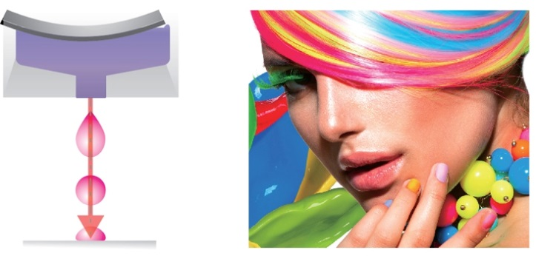
Waveform Control
Highly accurate dot placement
  Each color has its own specific gravity and viscosity
  Printhead jets each ink color at the appropriate jetting
  angle without losing precise ink droplet circularity
  Ejects ink in a straight line with a near-perfect circle
  Ink dots do not overlap
Less misting
  Crisper letters, lines, edges, etc.
Optimized to greatly minimize nozzle-out
When ink droplets are deformed in-flight (above), they do not result in accurate placement because either the jetting angle is out of tolerance or droplets break in the air.
With Mimaki Waveform technology (right), ink droplets are placed precisely without deformation because they maintain high circularity in-flight.

Slide 9
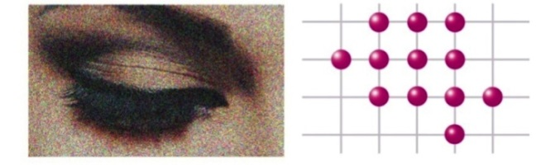
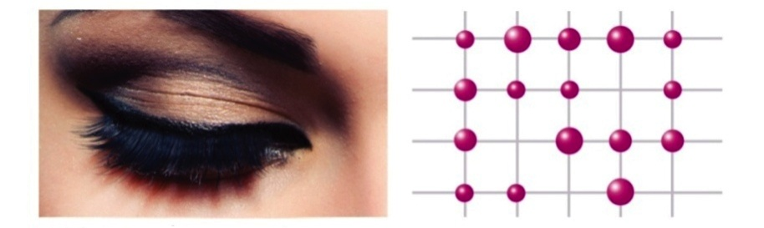
Variable Dot Printing
Three dot sizes
  4, 7, 8, 14, 16, 24, 35 pl
  Selected depending on ink type and print mode
    Embedded in profile
  Small drop delivers smoother gradients and quartertones
  High density drop produces uniform solids
    Enables higher print speeds
Fixed dots result in a grainy image.
Variable dots deliver smoother images.
Notes:
Droplets can range from 4 to 35 picoliters. Printer currently profiled to fire up to 3 droplet sizes per model.

Slide 10
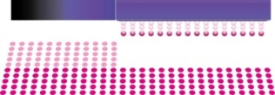

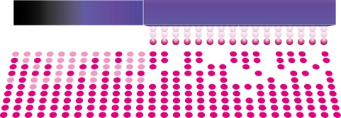

Mimaki Advanced Pass System 3 (MAPS3)
Anti-banding technology
  Prints in a gradational mask pattern
Ensures precise and accurate print quality throughout the printing process
Smoother image with no distinct bands
In normal printing, the edges between gradations are visible, resulting in banding.
MAPS3 technology uses a gradational mask pattern resulting in a smoother image with no distinct bands.
Notes:
New for the JV300 – MAPS3 technology uses Mimaki’s exclusive gradational masking to produce higher quality images, with no distinct banding, even when using high speed modes.

Slide 11
Ink Sets
SS21 Eco-Solvent Inks
Sb53 Dye Sublimation Inks

Slide 12




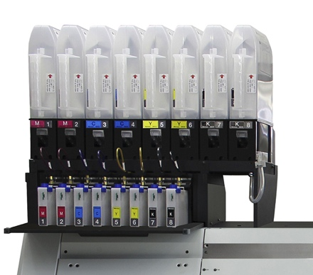

SS21 Eco-solvent Inks
Fast-drying
Ten available colors
  Silver ink available
Four configurations
  Six-color with White and Silver
  High speed printing
  High density white
  Smooth, vibrant colors
No blocking or bleeding
Print on hundreds of media choices
Mimaki Bulk Ink System 3 (MBIS3) - Standard
  2L ink pouches for select colors
  440 ml cartridges available
  White and Silver available in 220 ml cartridges only
Notes:
With one Mimaki JV300 Series printer, you can produce a variety of printed media for campaigns that include indoor and outdoor component such as retail promotions, and be assured of color and quality fidelity.

Slide 13

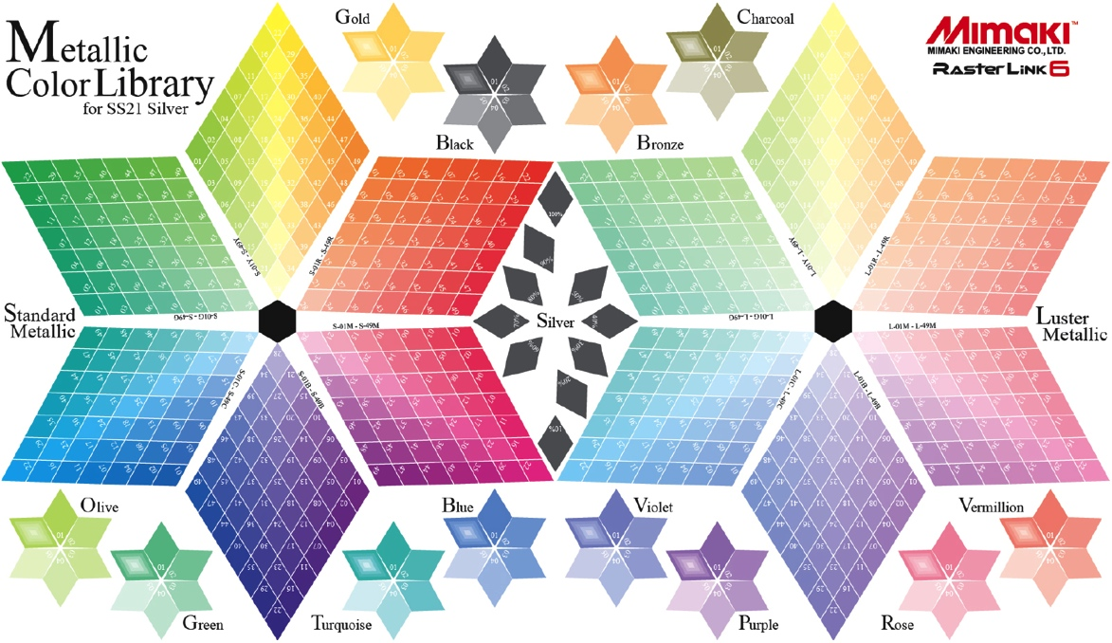
Silver Ink
For high-intensity, metallic effects
  More than 50 percent improvement on refraction over current formulation
Delivers brilliant mirror-effect results even when overlaminated
  Lamination is recommended to provide scratch resistance
Easy color matching with swatch palette of 648 metallic colors
  Print Silver then color
Outdoor-durable (UV resistant) up to one year
Notes:
Brilliance is not diminished even if overlaminated. RasterLink6 software includes swatch palette of 648 metallic colors that are easily selectable from Illustrator.

Slide 14
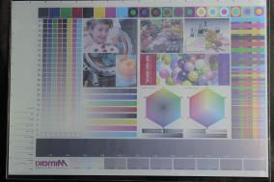
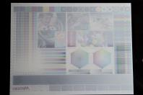
White Ink
48% greater density
  Due to larger ink droplet
  Enables more accurate colors to be printed on top of the white layer
Higher productivity
  430% faster print speed
Includes Mimaki Circulation Technology
  Prevents settling of ink pigments
CJV300 Series printers can achieve
3-layer printing
  Ideal for creating day/night backlits or window clings
    Color → White → Color
 | Test print
JV33-160 | Printer | CJV300-160
720 x 1440 | DPI | 720 x 1440
32 pass, bi-directional | Mode | 32 pass, bi-directional
14 pl | Max. drop size | 24 pl
0.27 | Transmission density | 0.40
9.68 | Speed (SqFt/Hr) | 41.97
Notes:
The larger drop size of White ink enables up to 430% faster printing while delivering up to 48% greater white area density.

Slide 15


Orange ink
Increases the color gamut
  Colors are more vibrant
Added as a process color
  No need to prepare artwork in a hexachrome color space
Reproduces approx. 94.8% of PANTONE® color chart
  Ideal for
    Corporate colors
    Skin tones
    Pastels
Even when using a six color ink configuration, some colors can look ‘muddy.’
Images printed with Orange ink appear brighter, ‘fresher.’
––– CMYKLcLmLkOr
––– CMYK
○ Approx. PANTONE colors
Notes:
Adding orange allows you to increase the color gamut, hitting nearly 95% of PANTONE colors

Slide 16


Light Black ink
Produces high quality monochrome images
  Smooth output
  No color rolling/rainbow
    Eliminates red undercast
Use with Lm, Lc and Or to serve the high-end, fine art markets
Using conventional inks only often results in a reddish cast to the image.
Light Black enables neutral gray reproduction, resulting in more accurate monochrome images.
Notes:
Light Black enables neutral grey reproduction while minimizing color rolling/rainbow effects.
A quick check of the internet shows that black-and-white digital photography is enjoying growth, and these photographers – professional as well as weekenders – want to see their prints on media replicated exactly as they were shot. Light Black ink gives you the ability to meet the demanding needs of these fine-art clients, who are often willing to pay a premium for their priceless personal expressions.

Slide 17



Sb53 Dye-sublimation Inks
Six available colors
Configure to fit the application
  High speed printing
  Smooth, vibrant colors
Mimaki Bulk Ink System 3 (MBIS3) - Standard
  2L ink pouches for all colors
  440 ml cartridges available
For sublimation transfer to polyester substrates
  Sportswear
  Soft signage
  Home decor
Notes:
Mimaki is known for its textile printing capability and the JV300 Series with SB53 dye sublimation inks is no exception.

Slide 18
Print Speeds – Select Examples
SS21 – CMYK x2
SS21 – CMYKLcLmLkOr
SS21 – White
SS21 – Silver
Sb53 – BMYK x2

Slide 19
SS21 – CMYKx2
Banner Print Modes
Square Feet per Hour
360x360, 1P, Bi
540x360, 2P, Bi
540x360, 3P, Bi
540x720, 4P, Bi
720x1080, 6P, Bi
720x1440, 10P, Bi
Above select modes and resulting speeds were printed using Banner print modes; test runs performed by Mimaki Engineering, Japan. Additional print modes are available.
Notes:
We tested a competitor’s product using its “High Speed” mode of 540x360 and the competitor’s print speed was 334 SqFt/Hr. The comparable-quality JV300 mode is “Draft” with a print speed of 745 SqFt/Hr.

Slide 20
SS21 -- CMYKLcLmLkOr
Banner Print Modes
Square Feet per Hour
360x360, 2P, Bi
540x360, 4P, Bi
540x360, 6P, Bi
540x720, 8P, Bi
720x1080, 16P, Bi
720x1440, 24P, Bi
Above select modes and resulting speeds were printed using Banner print modes; test runs performed by Mimaki Engineering, Japan. Additional print modes are available.
Notes:
Even “fully-loaded” with Light Cyan, Light Magenta, Light Black and Orange, the print speeds are in the production range. These lower print speeds can be offset by the higher premium charged for photo-realistic quality prints.

Slide 21
SS21 – White (CMYLLcLmWW)
Square Feet per Hour
1-layer printing, White only
3-layer printing, Color>>White>>Color
720x1080, 12P, Bi
720x1080, 18P, Bi
720x1080, 18P, Bi
720x1080, 24P, Bi
720x1440, 32P, Bi
720x1440, 32P, Bi
Above select modes and resulting speeds were performed by Mimaki Engineering, Japan. Additional print modes are available.
Notes:
White ink – particularly 3-layer printing capability – opens the range of applications considerably. Many customers who originally didn’t think they needed White ink have since commented that they have taken in so much more business because of it. Window clings, backlit images, printing on non-white substrates – plus more – can be produced.

Slide 22
SS21 – Silver (CMYKLcLmWSi)
Square Feet per Hour
1-layer printing, Silver only
Metallic color printing (Silver >> Color)
720x1440, 16P, Bi
720x1080, 12P, Bi
720x1440, 32P, Bi
720x1440, 16P, Bi
1440x1440, 32P, Bi
1440x1440, 32P, Uni
Above select modes and resulting speeds were performed by Mimaki Engineering, Japan. Additional print modes are available.
Notes:
Silver ink opens the range of applications. It can be used alone to provide brilliance to a monochrome image, or combined with a color to create eye-catching graphics. Choose from 648 metallic colors in the swatch palette. Combine with white as a base, add color from a swatch, and print on transparent media for window clings or package prototyping applications.

Slide 23
Sb53 – BMYK x2
Square Feet per Hour
360x360, 1P, Bi
540x360, 2P, Bi
540x360, 3P, Bi
720x720, 4P, Bi
720x1080, 8P, Bi
720x1440, 10P, Bi
Sb53 dye-sublimation ink viscosity is lower than SS21 eco-solvent ink resulting in faster print speeds than eco-solvent. Above select modes and resulting speeds were performed by Mimaki Engineering, Japan. Additional print modes are available.
Notes:
The JV300 Series with SB53 inks offers high-speed printing onto cost-effective transfer paper for sublimation to a wide range of textiles.

Slide 24
Cutting Functions
Continuous Registration Mark Detection
Segment Correction
Cut and Print
Over Cut and Corner Cut
Half Cut, Die Cut and Dotted Line Cut
Auto Pull Back Printing
Additional Features

Slide 25
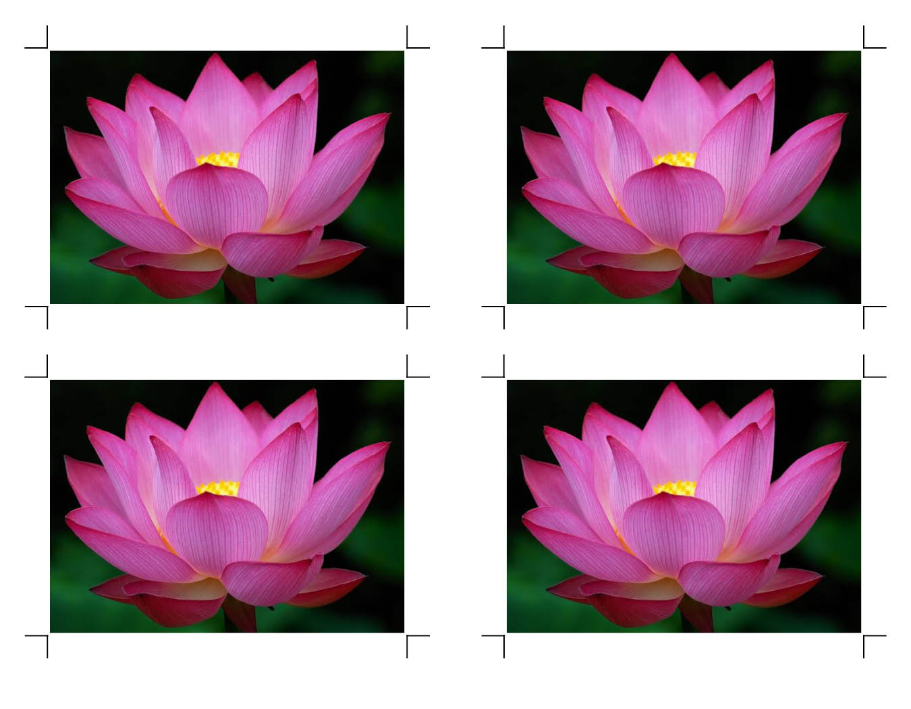
Continuous Registration Mark Detection
Crop marks are automatically and continuously detected
  Maximum four marks
Printed images are accurately contour cut
Compensates for distortion
Enables cutting of a whole roll of media without intervention
  Automatic take-up

Slide 26

Segment Correction
Detects intermediate crop marks in feed direction
Enables four-point corrections for each segment
  Accurate, long-length cutting
  Even if the image is distorted
Segment 1
Intermediate
crop mark
Segment 2
Intermediate
crop mark
Segment 3

Slide 27
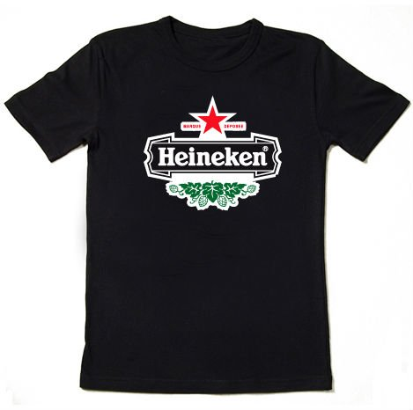
Cut and Print
Pre-cut before printing
Ideal for thin media
  Prevents film separation
Cut first capability is particularly useful for thin materials such as heat transfer media.

Slide 28
Over cut and Corner Cut
Over cut makes a cross-cut at start and end positions
  Results in sharp edges with no undercut fragments
  Range can be set between
  0.1 mm – 1.0 mm
Corner cut makes cross-cuts at each corner
  Reduces waste by ensuring clean edges
1.0mm
1.0mm

Slide 29
Half Cut, Die Cut and Dotted Line Cut
Half cut
  Leaves the backing sheet
Die cut
  Cuts through the backing sheet
Dotted line cut
  Cuts a series of half and die cuts leaving a few minimal joints

Slide 30
Features for Productivity
Nozzle Check Unit (NCU)
Nozzle Recovery System (NRS)
Media Heating System
Mimaki Bulk Ink System 3 (MBIS3)
Mimaki Circulation Technology (MCT)
Media Handling Features
Printer Stabilization
User Interface
Event Mail Notification

Slide 31
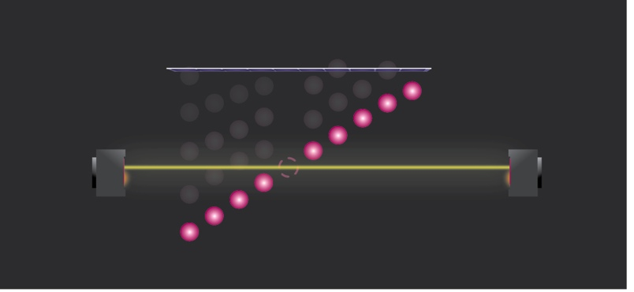
Nozzle Check Unit (NCU)
Checks for potential outages
  Cleans and re-tests before print run
  Reduces ink and media waste
  Reduces downtime
Operation flow
Nozzle check timing
1/After printing one transferred file
2/After printing set print length
Checks nozzles
The number of the cleaning repeats can be customized
All nozzles checked per nozzle line
Cleaning is done automatically
Printhead
Yes
Light emitting sensor
Light receiving sensor
Nozzle clogging?
Yes/No
When nozzles clogging
cannot be recovered
after repeated cleaning
Light emitting sensor
Light receiving sensor
No
Start printing
Nozzle recovery is automatically set
When the number of clogged nozzles exceeds registration capacity
Duration: 6-46 sec/nozzle check
Ink consumption: 5.3-686 cc/year*
When light passes through to the receiving sensor, the CJV300 determines that the ink is not being ejected properly and performs a cleaning function
Warning (Standby)
*based on one check per hour
x 10 hour operation per day
x 240 days
Notes:
The Nozzle check unit and Nozzle recovery system help to reduce media waste and minimize down time by using pre-print testing and nozzle mapping to reduce banding caused by clogs or mis-directions.

Slide 32
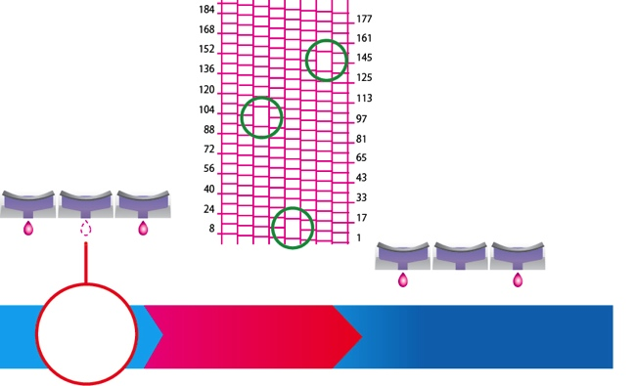
Nozzle Recovery System (NRS)
Enables continued productivity
  If a nozzle clog is not cleared via the maintenance function, other nozzles can be assigned to continue printing
    Reduces ink and media waste
    Print speed unaffected
  Up to 10 nozzles can be registered per nozzle line
  Available for most print modes
    Some circumstances are not compatible with NRS
      Nozzle condition
      Lower passes
        e.g. 2-pass 540x360 or 4-pass 540x720, etc.
      Some MAPS3 modes
  Check location of clogged nozzle and set recovery function
Clogged
nozzles
Clog
occurs
Register nozzle number
Continue printing

Slide 33
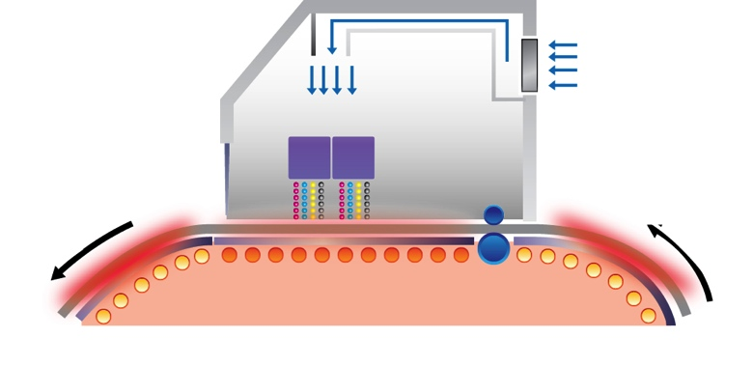
Media Heating System
Uniform media drying for consistent results
  Three-way, intelligent heating system
    Heats media to proper temperature
    Quick drying and accurate fixation
  Top blower incorporates airflow path
    Helps control dot size by drying ink from its surface
  Heats across the entire width
    No undesirable artifacts
    at edges
  Ceramic heaters use
  less energy
    Lower operational cost
  Patented system
    USA: 8.444.262; Japan: 4889059; China: ZL 200910222559.8
  1 Pre heater
  2 Print heater
  3 Post heater
  T Top blower
  P Printheads
T
P
Media direction
1
2
3

Slide 34
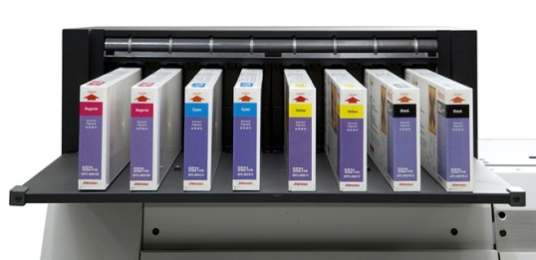
Mimaki Bulk Ink System 3 (MBIS3)
Standard on all CJV300 Series printers shipped in North America
  2 liter ink pouches for select colors
  440 ml cartridges for other colors
  White and Silver ink available in 220 ml cartridges only
  Enables continuous long prints
    Overnight or unattended printing possible
  Reduced ink cost vs. cartridges
Notes:
MBIS3:
Reduces ink costs when compared to cartridges
Enables unattended printing
so your operators can be free to do other tasks
capable of overnight print runs – imagine making money while you sleep!
The only 2L bulk ink system available for eco-solvent printing

Slide 35
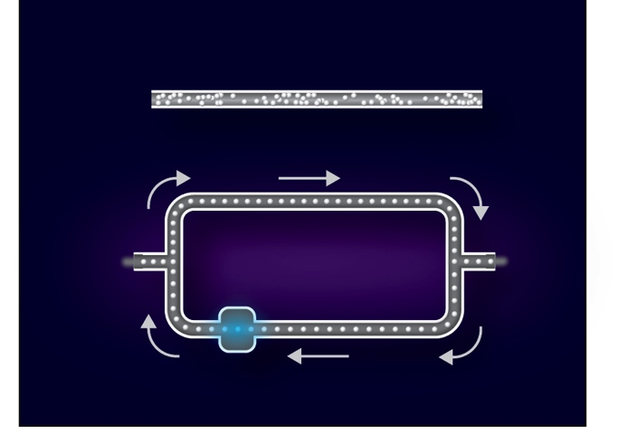
Mimaki Circulation Technology (MCT)
For White and Silver Ink only
Ensures stable print quality
  Prevents white pigment settlement
  Greatly reduces nozzle clogging
Reduces ink and media waste
W or Si ink
Settles without circulation
White ink
Settles without circulation
With circulation
With circulation
Ink supply
Print-head
Ink supply
Print-head
Pump
Pump

Slide 36
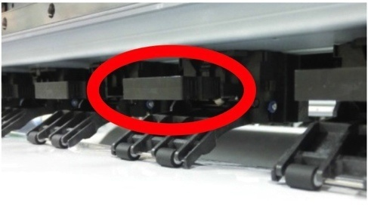
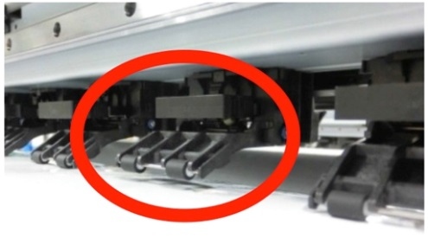
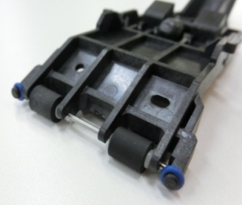
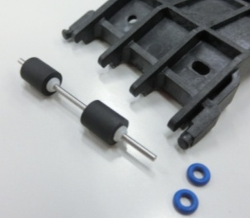
Media Handling: Independent Pinch Rollers
Can be individually adjusted
  From light and delicate to heavy and stiff
  More accurate printing with less media damage
    Reduces media waste
Extended pinch rollers reduce cockling at edges
Pinch rollers can be easily disassembled
  Simply remove blue rubber band
  Easy replacement when worn
The operator can manually push down on the lever when the pinch roller is in the down position …
… to raise it off the media – each pinch roller can be adjusted independently

Slide 37
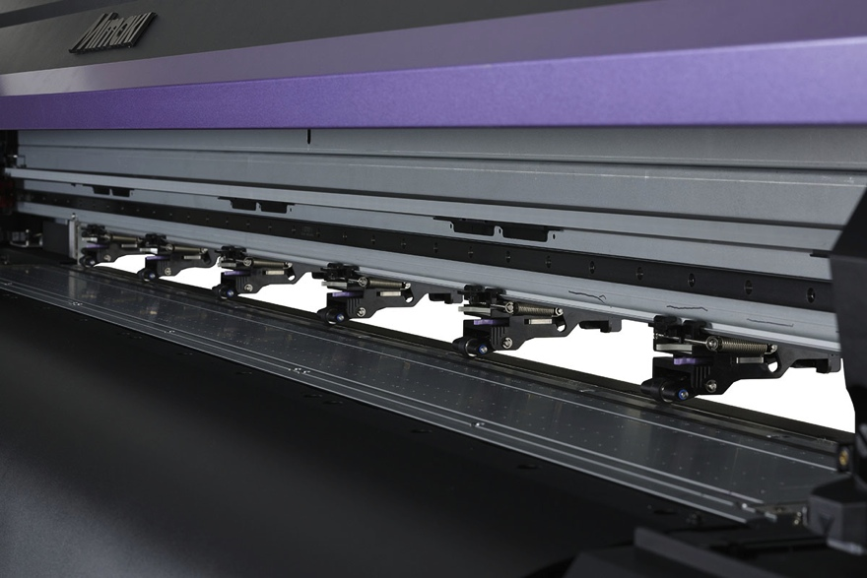
Media Handling: Auto Engage/Disengage
Enables continuous printing and cutting
  Three pressure settings can be selected depending on material used
  No operator intervention required to manually adjust pinch rollers from the start of printing to the end of cutting

Slide 38
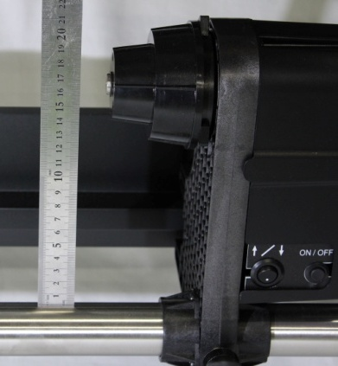
Media Handling: Feed and Take-Up
Supports rolls up to 88 lbs. (40 kg)
  Strong torque on take-up unit helps feed media
Accepts rolls up to 9.8” (250 mm) in diameter
  Take-up roll height of 6.7” (17 cm)
    More than 2” higher than JV33
High feeding accuracy
  Measured by a sensor
    As the diameter becomes larger, the take-up length becomes shorter
    Keeps media tension constant
6.7”
(17 cm)
Take-up roll switch:
Roll up media by simply pressing the button
Notes:
The media feed and take-up system enables continuous operation.

Slide 39
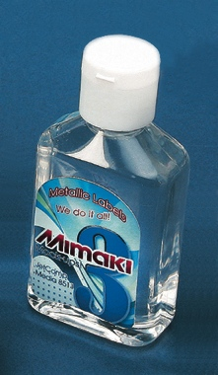
Media Handling: Auto Pull Back
Printing high density color over Silver
Media is automatically repositioned
  Print Silver and background field (if applicable)
  Auto Pull Back repositions media
  Print Color over Silver

Slide 40
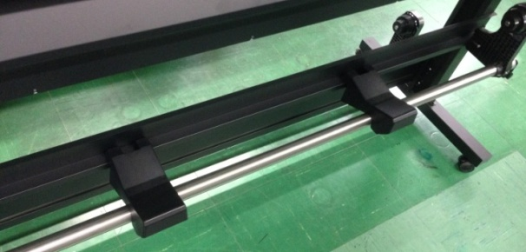
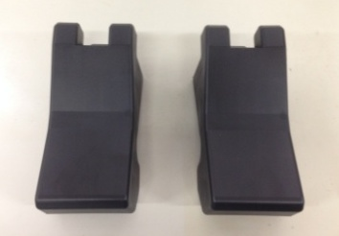
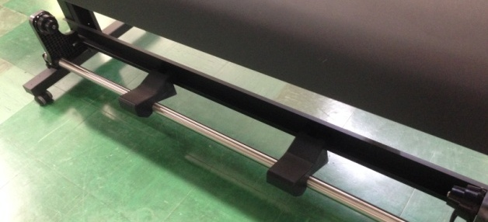
Media Handling: Media Stand
For temporary placement at back or front
  Helps support loading and unloading of heavy rolls
Installed on the back side
Media stand
Installed on the front side

Slide 41
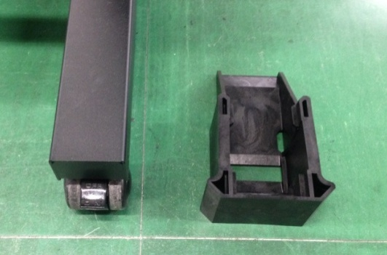
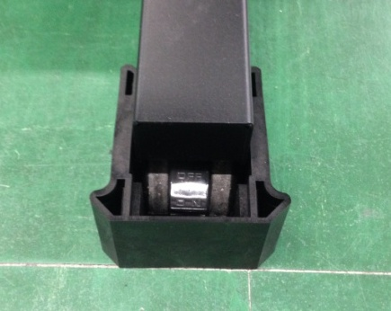
Printer Stabilization
Lift Up Block
  Prevents printer shaking
  Prevents printer “walking” on hard surfaces if casters aren’t locked
  Easy installation
    Raise the printer slightly and slide the Lift Up Block under the caster
Installed
Lift Up Block

Slide 42
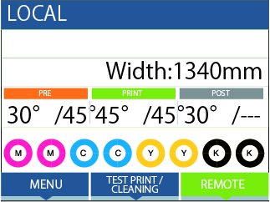
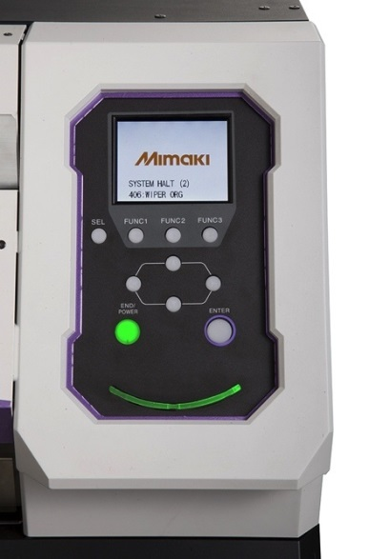
User Interface
Color LCD Control Panel
  3.45-inch color display panel for easy operation
  View data such as media width, heater temperature and remaining ink volume
Multi-language display
  Including French, Spanish and Portuguese (availability TBD)
LED displays printer status at a glance
  Blinking Blue: Normal operation
  Blinking Red: Error condition
Notes:
(Spanish and Portuguese language availability TBD)

Slide 43
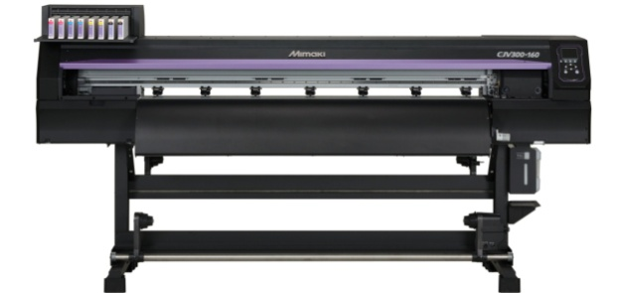


Event Mail Notification
Print status sent via email
  Start, finish, error messages
Printer status can be monitored remotely
Internet
Print start/complete
Error/Warning
LAN
Email on smartphone
USB

Slide 44

Key Features
New Functions
Multi-Color Matching Profile
Cut Data Creation

Slide 45
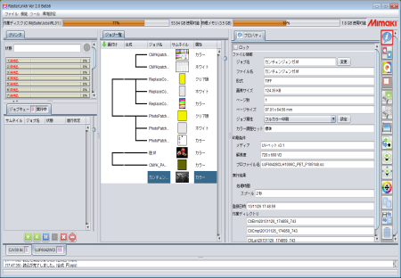
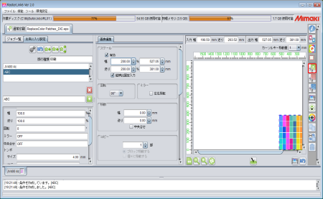












Key Features
Main information on one screen
  Printer status, RIP progress, job status, etc.
  Nesting or job composition displayed visually
Register frequently used settings in “My Favorites”
  Up to 30 settings can be registered
Intuitive icons enable quick and easy job control

Slide 46
New Functions
Profile batch printing
  Print images based on different profiles together
  Effective for printing on new media
  Enables quick and easy selection of optimal profile
Three-layer printing
  Ideal for creating day/night backlits or window clings
    Color → White → Color
Web Update function
  Quick access to updated features
  Access profiles
Convenient functions
  Estimated Completion Time display
  Enhanced layout function
  Print Status display

Slide 47
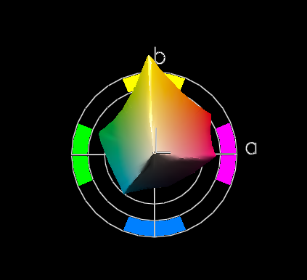
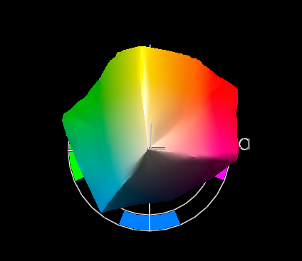
Multi-color Matching Profile
WideMimaki2013forSign profile
  Wide color reproduction range of orange area
  Based on WideMimakiCMYK profile
    Larger general color reproduction domain for a wider color reproduction of orange area
  Generates brilliant color reproduction with higher intensity
  Light colors (skin tones, pastels) will be brighter
WideMimakiCMYK
WideMimaki2013forSign
Gamut viewer:
X-Rite ProfileMaker

Slide 48
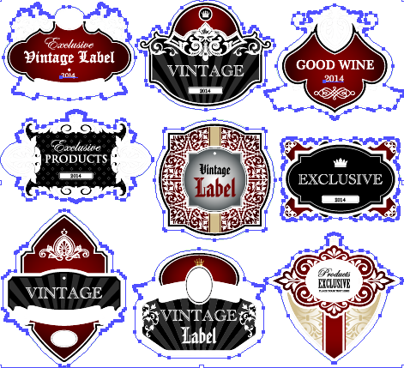

Cut Data Creation
Print and cut data easily created by RasterLinkTools
  Illustrator plug-in
RasterLink6 recognizes spot color path as a cut line
Crop marks can be attached in RasterLink6
Extracts frames and specifies as spot color “Contourcut”
Select images
Click “Frame Extraction”

Slide 49
Preparing for Installation
Specifications
System Configuration
Packing / Installation

Slide 50
Specifications
 | CJV300-130 | CJV300-160
Printhead | On-demand piezo head (staggered dual-head)
Resolution (DPI) | 360, 540, 720, 1080, 1440
Drop size | 4 to 35 picoliters
Head height | 2.0mm/2.5mm/3.0mm * manual adjustment (+1.0mm or +2.0mm)
Ink type | SS21 Eco-solvent ink available in C M Y K Lc Lm Lk Or W Si Sb53 Dye-sublimation Ink available in B M Y K Lb Lm
Ink capacity | SS21: 2L ink packstandard for select colors; 440 ml cartridges available (White and Silver in 220 ml cartridges only) Sb53: 2L ink pack standard for all colors; 440 ml cartridges available
Max. printing width | 53.5 inches (1361 mm) | 63.3 inches (1610 mm)
Max. media width | 53.9 inches (1371 mm) | 63.7 inches 1620mm
Max. media thickness | 0.039 inches (1.0mm)
Max. roll weight | 88 lbs. (40 kg)
Cut speed | 11.8 inches (30 cm) per second max; 1G acceleration max
Dimensions WxDxH (assembled, with MBIS3) | 101 x 28 x 71 inches / 254 x 71 x 179 cm | 110 x 28 x 71 inches / 280 x 71 x 179 cm
Packing size (printer only) | 105 x 30 x 42 inches / 266 x 75 x 105 cm | 115 x 30 x 42 inches / 291 x 75 x 105 cm
Body weight | 368 lbs. / 167 kg | 392 lbs. / 178 kg
Power supply | Single phase (AC100～120V ±10％ ) x2, 50/60Hz ±1Hz
Power consumption | (100V) Max 1440W x2
Applicable standards | VCCI class A / FCC class A / UL60950-1ETL / CE Marking (EMC, Low Voltage and Machinery) CB report / RoHS / REACH・CCC (pending)・Energy Star / RCM

Slide 51
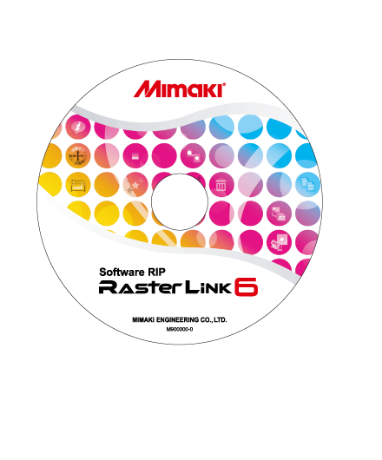







System Configuration
Commercially Available Design Software
  Supports PS, EPS, TIFF, BMP, JPEG, etc.
<RIP Software> standard accessories
Output / Installation
Recommended Computer Specifications
CPU: Core i5, 3.2 GHz
Memory: 8 GB
Hard drive: 500 GB
USB 2.0 ports: Minimum 4
Optical disc drive: DVD-ROM
OS: Windows 7 Professional 64-bit
Monitor: 1366x768
(USB 2.0 cable 5 m or shorter is recommended)
Options
AMF Kit: Tension Bar
Static Prevention Sheet
Drying Fan (avail 10/14)
Air Exhaust Unit (avail 10/14)

Slide 52
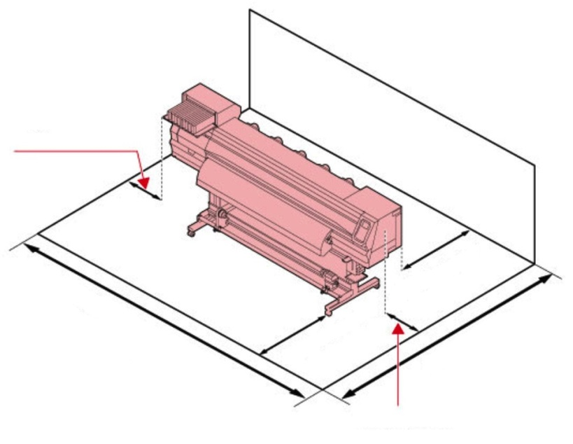
Packaging / Installation
Model | Width | Depth | Height | Weight | Manpower for installation
CJV300-130 | 105 in. / 2662 mm | 30 in. / 750 mm | 42 in. / 1050 mm | 492 lbs. /223 kg | 4 people
CJV300-160 | 115 in. / 2912 mm |  |  | 525 lbs. /239 kg
Minimum installation clearances below
Ensure installation floor can safely accommodate weight
Use in a well-ventilated environment
Environmental temperature: 65-86˚F / 20-30˚C
Quality assurance temperature: 65-77˚F / 20-25˚C
Humidity: 35-65% RH (non-condensing)
Temperature gradient: +/- 50˚F / 10˚C per hour maximum
Dust: equivalent to office environment
Do not install on carpets or any surface that can cause static electricity, which can affect image quality
Do not install near where chemicals (e.g. photographic fixer, acetic acid, hydrochloric acid) are used
Diagram at left does not include installation area for PC
20” / 50 cm
40” / 100 cm 40” / 100 cm
107” / 270 cm
139” / 353 cm for CJV300-130
149” / 378 cm for CJV300-160
20” / 50 cm

