Slide 1

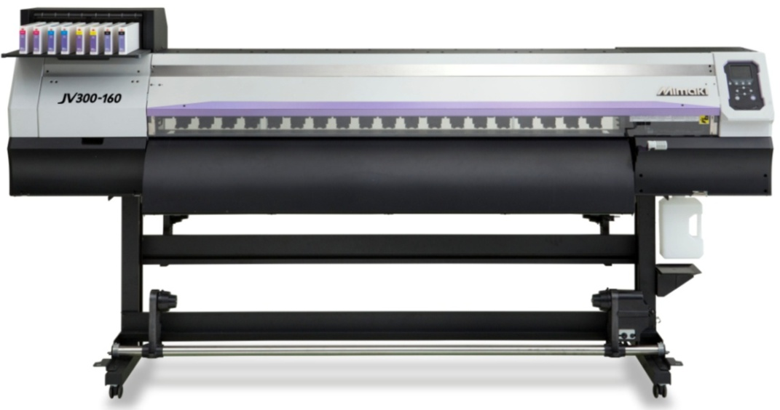
Wide Format Inkjet Printer for Sign & Graphics
Product Guide
Outstanding Speed,
Stunning Beauty
+
Global Marketing Department
Ryosuke Nakayama
June 20, 2014
Ver1.3
Note : The information in this document is subject to change without notice.

Slide 2
Key Features
Outstanding Speed
  High productivity with staggered dual-head design and large droplet
    2 print heads aligned in stagger configuration performs wide band printing
    Max drop size of 35pl enables high speed & high density printing
  Less bleeding results even in high speed printing
    High speed and high density printing without bleeding by fast drying ink,
    SS21, and 3-way intelligent heater
Stunning Beauty
  Brilliant color reproduction by various colors
    Orange ink delivers wider color gamut printing
    Light black ink produces accurate grayscale printing without color shifts
    White ink ensures high opacity on transparent media
  Mimaki’s original technologies to perform high quality printing
    Smooth image quality by waveform control and precise dot placing technology
    3-way intelligent heater optimizes dot sizes
    MAPS3* eliminates banding and produces uneven print density
    (*Mimaki Advanced Pass System 3)

Slide 3

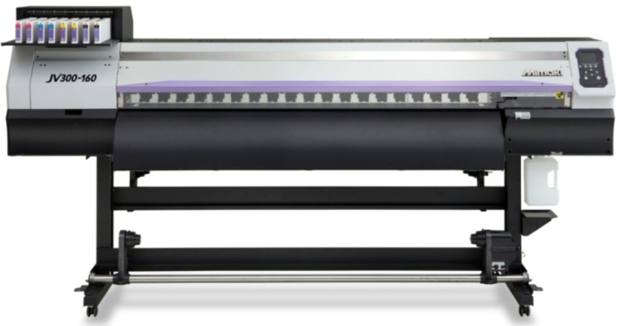
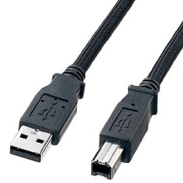
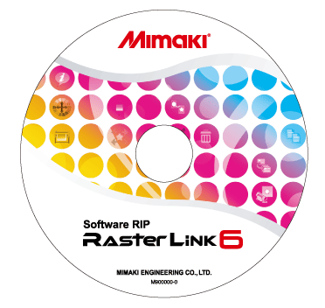

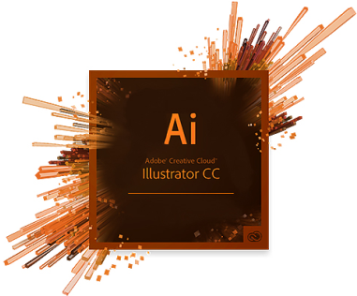
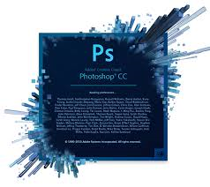

System Configurations
〈PC〉
JV300 System configuration
USB2.0 cable of 5m(15ft)
is recommended
Recommended specifications
CPU：Core i5 3.2GHz
MEMORY：8GB
HDD：500GB
USB2.0：4 ports or more
Optical disk drive：DVD-ROM
Windows7 Professional 64bit
Monitor1366x768
＜RIP software＞ bundled
〈Design software〉
Option
・AMF130(160)KIT: Tension Bar
・MBIS3: Mimaki BulK Ink Supply Unit
・STATIC PREVENTION SHEET FOR 300-130
(160): Static Cling Prevention Sheet Kit
・Drying Fan (Available in Oct. 2014)
・Air exhaust unit (Available in Oct. 2014)
※Complaint with PS,EPS,TIFF,BMP,JPEG, etc

Slide 4
Ink Type / Ink Set
SS21
BS3
Colors
9C :
4 ink set selections
①4C : High speed printing
②8C : Smooth result & vibrant expression
③6C+WW : High density white printing
Colors
4C :
Ink set
①4C : High speed printing
Ink capacity
CMYK:
①600ml Ink pack(w/ Eco-cartridge)
②2L Ink pack(for MBIS3)
Sb53
Colors
6C： *K ink is also available
Ink set
①4C : High speed printing
②6C : Smooth, bibrant colors
Ink capacity
CMYKLcLmLkOr:
①440ml cartridge
②2L Ink pack(for MBIS3)
W:
①220ml cartridge only
Ink capacity
BMYKLbLm:
①440ml cartridge
②2L Ink pack(for MBIS3)
※ES3 : To be available later

Slide 5
Outstanding Speed① Staggered dual-head
High productivity by wide band printing
Wide band printing by staggered dual-head arrangement performs high speed printing.
1-head:1440-nozzle(180-nozzlex8-line)
Staggered Dual-head
1
2
3
4
5
6
7
8
Nozzle length
Approx.25.4mm
(1 inch)
1
2
3
4
5
6
7
8
Approx.
50.8mm
(2 inch)
Nozzle width
Approx.31mm
(1.2 inch)
Approx. 101mm
(3.9 inch)

Slide 6
Outstanding Speed② Larger Ink drop
Large dot size
The maximum drop size of 35pl delivers high density printing even in high speed mode (low resolution mode). The maximum productivity of 105.9㎡/h *¹ is attained.
〈Case 1 : Maximum dot size =21pl〉
〈Case 2 : Maximum dot size =35pl〉
1 /360 inch
1 /360 inch
Large
21ｐｌ
Large
35ｐｌ
1 /360
inch
1 /360
inch
Middle
14ｐｌ
Middle
14ｐｌ
Small
4ｐｌ
Small
4ｐｌ
Low density due to gap between dots ↓
Not suitable for high speed mode(low resolution)
High density as no gap between dots
↓
Suitable for High speed mode
Not only the print mode using 360x360 dpi, but the other low resolution modes of
540x360 and 720x720 which have not been used are available. This delivers wide print speed coverage from high resolution mode to low resolution mode.
(Note : *1 – in case of banner printing)

Slide 7
Outstanding Speed③ 4C(CMYK) (SS21/BS3)
CMYK
PVC
Banner
㎡/h
㎡/h
The print modes in this document is the performance of the printer itself. The profiles are created selectively
depending on the media type. When the profile is not available, you can create profile by using MPMⅡ.

Slide 8
Outstanding Speed④ 8C/6C+WW (SS21)
CMYKLcLmLkOr/CMYKLcLm+WW
PVC
Banner
㎡/h
㎡/h

Slide 9
Outstanding Speed⑤ White printing(SS21)
White printing
Ink set: CMYKLcLm+WW
Fast drying of SS21 ink performs 3-layer printing using white ink.
When printing white ink only, the maximum print speed is 10.5㎡/h.
1-layer printing
(White only)
2-layer printing
(Color→White / White→Color)
㎡/h
㎡/h
3-layer printing
(Color→White→Color)
㎡/h

Slide 10
Outstanding Speed⑥ Sublimation (Sb53 4C/6C)
BMYDk(K)
BMYDk(K)LbLm
㎡/h
■2 kinds of black inks
㎡/h
Type | Advantage | Disadvantage
Sb53K | ・Less smoking at the time of heat transfer ・Less grainy appearance at the low gradation part | ・When printing in 100％, the density is the same as Dk ink, but the density is lower at the part of low gradation part.
Sb53DK | ・Reflection density is higher at the low gradation part | ・Grainy appearance at the low gradation part can be seen ・Smoke a lot while heat transfer compeered to K ink.
*When using Sb53 inks, the print speed is faster than eco-solvent ink. This is because the viscosity of
the Sb53 is lower, which enables ejecting ink faster.

Slide 11


Stunning Beauty (Color)① Orange ink with SS21
Wider gamut with new Orange ink
①Orange ink is added as a process color
②Approx. 94.8% of PANTONE color chart is covered*
③High reproducibility of corporate color, food, etc.
【Gamut comparison】
【Printed result comparison】
CMYKLcLm
CMYKLcLmLkOr
Less freshness without Orange ink
High reproducibility with bright, fresh Orange
Approximate colors of PANTONE
*PANTONE solid chips coated(1085 colors)

Slide 12

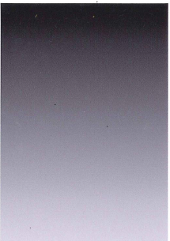


Stunning Beauty (Color)② Light-Black Ink with SS21
    High quality Monochrome color reproduction with new Light-Black ink
Good color balance without color shifts reproduce high quality monochrome
color, smooth and clear grey output
【Print result comparison①】
【Print result comparison②】
CMYKLcLm
CMYKLcLmLkOr
CMYKLcLm
CMYKLcLmLkOr
・Reddish grey
･No color shifts
and smooth gradation
・Reddish grey
・Skin w/grainy
appearance
・Clear grey
・Smooth skin

Slide 13
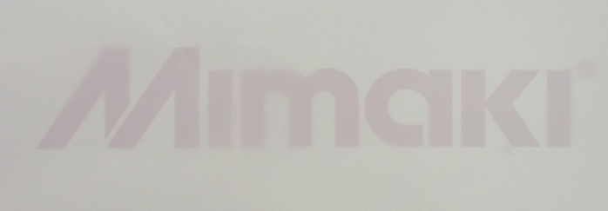
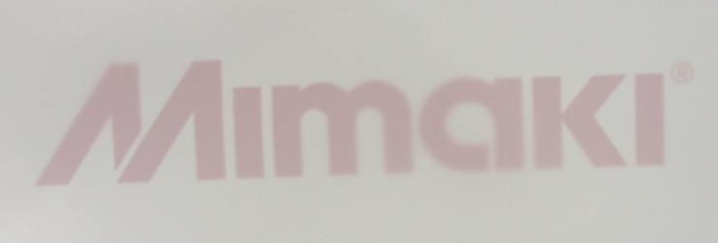
Stunning Beauty (Color)③ High opacity print with white ink
White Ink
①Vivid color expression even on transparent/colored media by printing
white ink before printing color
②Higher opacity printing is attained by larger ink droplet*
【Density/Opacity comparison (White - single layer)】
Print White in 100%(Density set on RL6) → Put Mimaki logo underneath and light up
from the back-side
JV300-160
JV33-160
Transmission density:0.40
Transmission density: 0.27
Density：48%UP
Productivity：430%Up
Print mode:720x1440,32P,Bi
Productivity:3.9㎡/h
Maximum drop size: 24pl
Media: PET(SPC-0641-62)
Print mode:720x1440,32P,Bi
Productivity:0.9㎡/h
Maximum drop size: 14pl
Media: PET(SPC-0641-62)
*The white ink of SS21 is same as the conventional white ink. The higher density print is
accomplished by the larger ink droplet.

Slide 14




Stunning Beauty (Quality)① Waveform Control Technology
Waveform Control Technology for high quality printing
①Jetting ink drops in straight with almost a perfect circle dots accomplishes high accuracy
dot placement
②Waveform which has less mist is adopted to print crisp letters, lines, edges, etc.
③Waveform is optimized in a way not to cause nozzle-out
Ejects ink in straight
with a near-perfect circle
Ejects ink not straightly and
not with a perfect circle
Ink dots do not overlap and accurate dot placement
↓
No grainy appearance
Ink dots overlap and not accurate dot placement
↓
Grainy appearance and uneven density

Slide 15

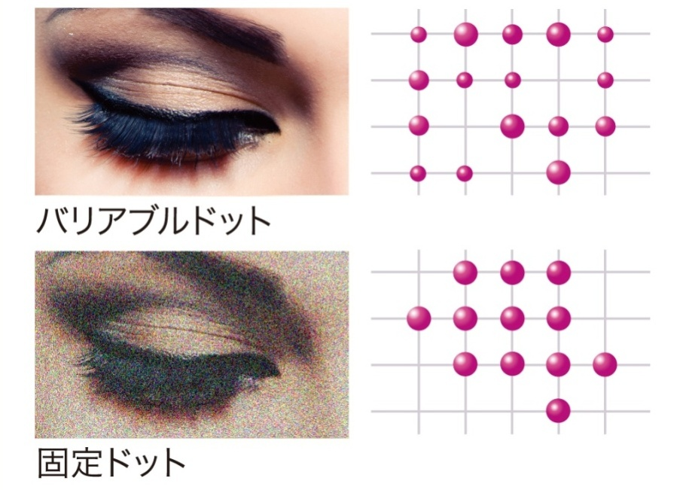
Stunning Beauty (Quality)② Variable Dot Technology
Variable Dot
The variable dot technology, printing in 3 different dot sizes of large, medium, and small, delivers the high image printing with very smooth gradations.
Variable dot
Normal dot
3 different drop sizes are selected from 4pl/7pl/8pl/14pl/16pl/24pl/35pl depending on the ink type and print mode. The combination of the 3 drop sizes
are embedded in profile.
Having wide range of dot sizes, not only high resolution printing for high quality but high speed & density printing for high productivity is attained.

Slide 16
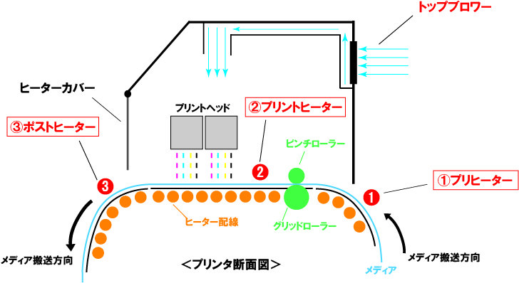
Stunning Beauty (Quality)③ Optimizing Dot Size
3Way Intelligent Heater plus Top Blower
①Ensures higher print quality without smear by quick and accurate ink dots fixed
with heating media to proper temperature by Pre and Print heaters
②Post-heater provides additional drying after printing
③Top blower controls dot sizes by drying ink from its surface
【3-way Intelligent Heater (Mimaki’s patent)】
Patent number
Japan | 4889059
USA | 8.444.262
China | ZL 200910222559.8
Top blower
Air flow onto the surface of the ink controls dot sizes.
Heater cover
Print-head
②Print-
heater
③Post-heater
Pinch roller
Larger Post-heater than JV33 to ensure faster drying in faster printing.
①Pre-heater
Grid roller

Slide 17
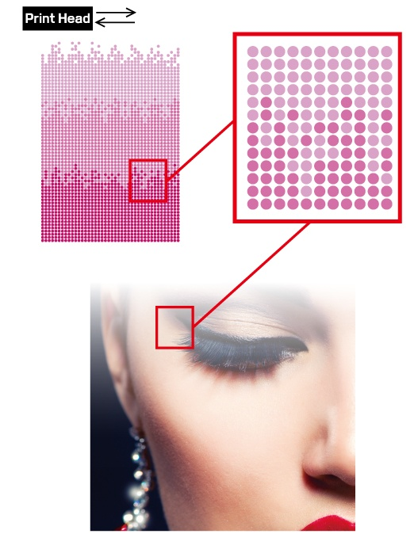
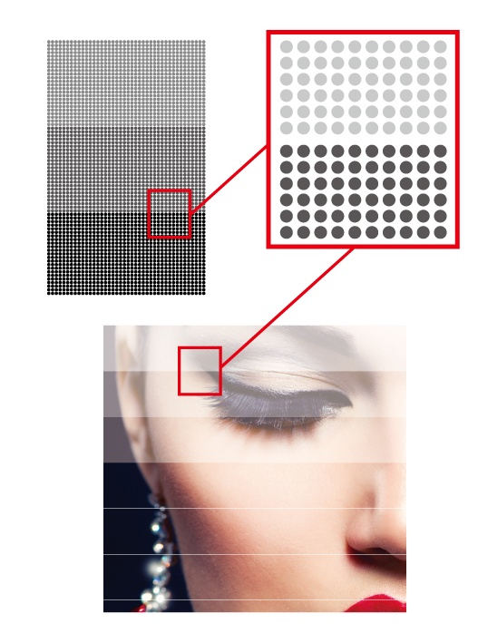
Stunning Beauty (Quality)④ MAPS3
MAPS3 (Mimaki Advanced Pass System 3)
MAPS3 prints passes in gradation-like tone by dispersing ink drops between passes, allowing for reducing banding, uneven drying inks, and bidirectional stripes.
【MAPS3】
【Normal Pass】

Slide 18

Continuous Operation① NRS (Nozzle Recovery System)
Less downtime by NRS
Even if the nozzle clogging is not improved by the maintenance function, the continuous printing operation without losing image quality is possible by using the other nozzles registering clogged nozzle in the printer.
Nozzle check pattern
Register the number of clogged nozzles
Clogged nozzles
Use the other nozzles instead of clogged nozzles
･10 nozzles can be registered per 1 nozzle line
･The print speed does not change by using NRS
･Depending on the condition of the nozzle, NRS does
not work
･When using low passes, NRS does not work
･When using MAPS3, NRS may not work in some mode
【Continuous printing by NRS 】
Down Time
Continuous Operation

Slide 19
Continuous Operation② NCU (Nozzle Check Unit)
Unattended printing with stable image quality
NCU checks the nozzle condition automatically per transferred file or set print length.
①When nozzles are clogged, cleaning is automatically executed. Printing with the
nozzle clogged is avoided.
②When nozzle clogging is not recovered by cleaning, Nozzle Recovery System is
automatically done, and start printing.
【Image of NCU function】
【NCU operation flow】
Nozzle check timing
①After printing one transferred file
②After printing set print length
Print head
Ink ejection by each nozzle line
Sensor：
Check each nozzle ejection
Checks nozzles
The number of the
retrying cleaning can
be customized.
All nozzles are checked per nozzle line
Nozzle Clogging
Yes/No
Cleaning is done automatically
Light emitter
Receiver
Yes
When nozzles clogging
could not be recovered
after retrying cleaning.
No
Sensor：
Receiver detects a light→ no ejecting→Cleaning
Start printing
Nozzle recovery is automatically set
Nozzle check duration：6-sec./check
Nozzle check ink consumption：5.3 cc/year *
*Operating Condition: One check/hour x 10-hour operation/day x 240-day
When the number of clogged
nozzles rise above capacity of
registerable number
Warning(Standby)
*¹ Timing for nozzle check can be set by hourly cycle

Slide 20
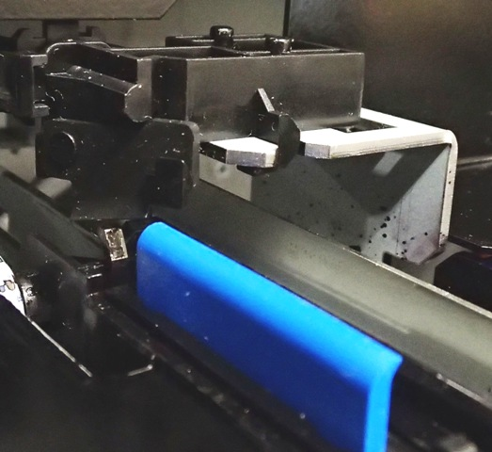
Continuous Operation③ Automatic Wiper Cleaning
Automatic Wiper Cleaning
①The ink on the wiper is automatically cleaned up after cleaning.
The ink on the wiper does not attached to the nozzles. This allows for the
stable firing of ink.
②The daily maintenance becomes easier because the wiper is cleaned up
automatically.
【Automatic Wiper Cleaning】
①Washing liquid
Wiper Cleaner
②Wipe out

Slide 21
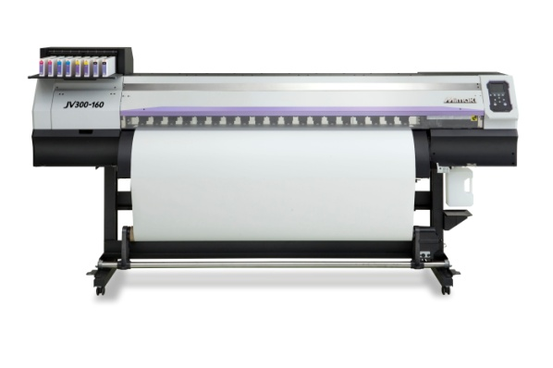

Continuous Operation④ Event Mail Notification
Event Mail Notification
*Various information can be sent from printer to mobile phone by email.
*Printer status can be monitored remotely allowing for unattended printing.
Internet
Print start/complete
Error/Warning
LAN
Mail reception
<Printer>
<Mobile phone>
<PC>
USB
Available in August,2014

Slide 22
Continuous Operation⑤ MCT(Mimaki Circulation Technology)
Stable print quality by MCT
By circulating the white ink in the line, the settlement of pigments is prevented. This allows for the stable printing with out nozzle clogging.
Ink lines
Circulates White inks in its lines
Pump
Ink lines
Pump
1
2
3
4
5
6
7
8
Nozzle width
About25.4mm
About 50.8mm
1
2
3
4
5
6
7
8
Width
About31mm
About 101mm
*¹ MCT works only when White and inks are used

Slide 23

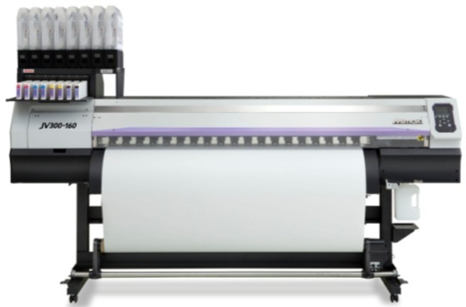
Continuous Operation⑥ Ink Supply Systems
● UISS*(Uninterrupted Ink Supply System)
In 4C ink-set, when the ink runs out, ink is
automatically supplied from the other cartridge
for the continuous operation.
*When using Sb53 6C ink set, UISS works with M and Bl.
Not available with 6C+WW and 8C ink sets.
M
M
C
C
K
K
Y
Y
● Non-Stop Ink replacement
In 4C ink-set, empty ink cartridge can be replaced with a new one without
stopping the on-going print job. No waste of time and media/ink.
*When using Sb53 6C ink set, UISS works with M and Bl.
Not available with 6C+WW and 8C ink sets.
● MBIS3(Mimaki Bulk Ink System 3) *Optional
Large volume of 2L ink packs are set directly on to
the ink station, ensuring continuous large print jobs.
New MBIS on the printer saves working space, and
large 2L ink pack saves running cost.

Slide 24
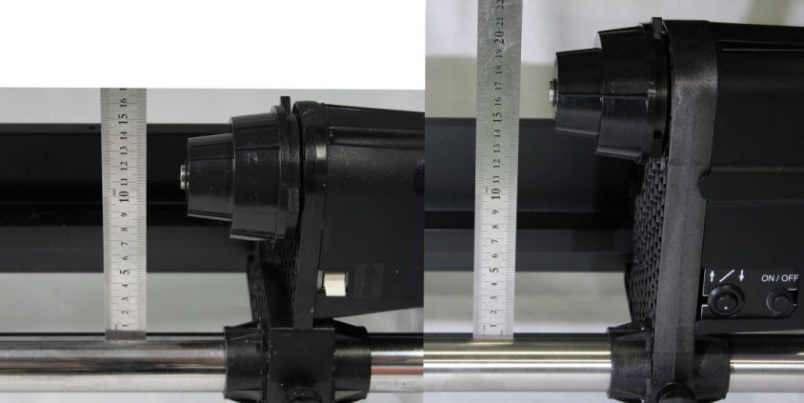
Continuous Operation⑧ Media feeding and take-up
①Media of up to 40kg can be used
The take-up roll unit of JV300 has a strong torque to feed media of 40kg
at the maximum.
②Maximum diameter of up to 250mm can be rolled up
The height of the take-up roll unit is 17cm, which is high enough to roll up
the media of the diameter of up to 250mm.
③Prints one roll of media with high feeding accuracy
The diameter of the taken-up media is measured by a censor. As the diameter
of media becomes bigger, the length to roll up the media becomes shorter.
This keeps the tension of the media constant.
17cm
11.5cm
【Take-up roll switch】
By pressing the button, the media is rolled up.
【JV33】
【JV300】

Slide 25
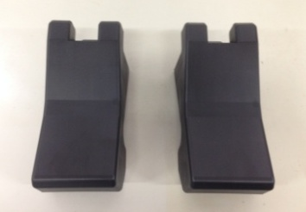
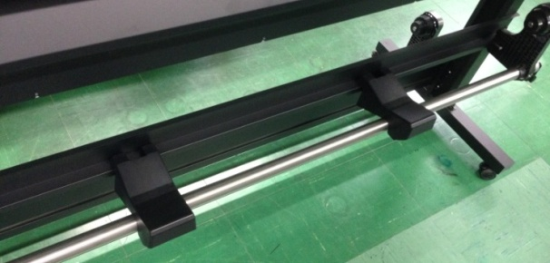
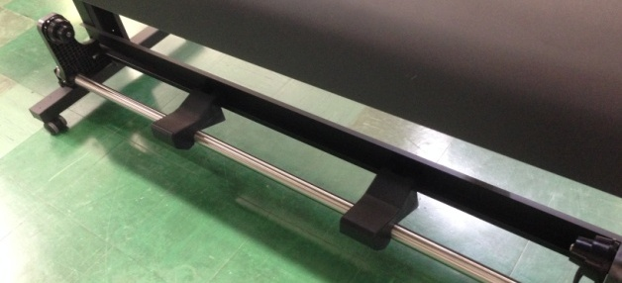
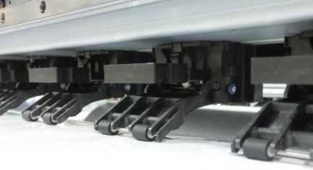
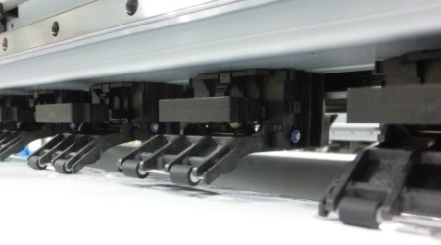
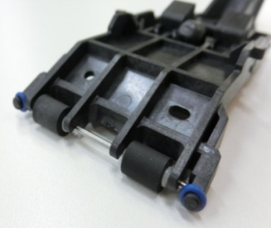
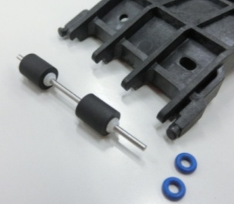
Optimize Work Efficiency① Media setting assists
①Media Stand
Media stands for temporal media placing is available at the back-side or
the front-side to support the installation and removal of heavy media.
Media stand
Back-side
Front-side
②Independent Pinch Roller
Adjust number of pinch rollers to be used depending on characteristics of media.
Push the red area
A pinch roller
lifts up
The pinch roller can be disassembled easily by removing small blue rubber band.
When the pinch roller become old, it can be replaced easily.

Slide 26
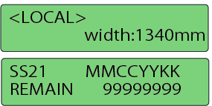
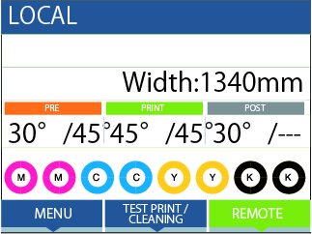
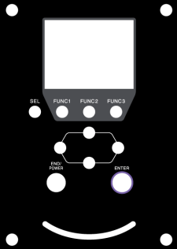
Optimize Work Efficiency② High Visibility Design
①Color LCD Control Panel
3.45inch(52.56mm x 70.08mm) color panel display for easy setting and operation.
【Conventional printer】
【JV300】
Various information are displayed in a graphical manner, such as media width, heater temperature, remaining ink volume.
Multi-language display
11 languages are available for convenience.
Selectable languages: Japanese/English/German/French/Italian/Spanish/Portuguese
Russian/Chinese/Korean/Thai
*At the time of releasing JV300, English and Japanese are available.
The other languages become available later.
③Status LED
LED status lamp tells you the status of the printer, and grasp the status
from a remote position.
【Status LED】
Blinking in Blue : Normal operation
Blinking in Red : Error occurred

Slide 27
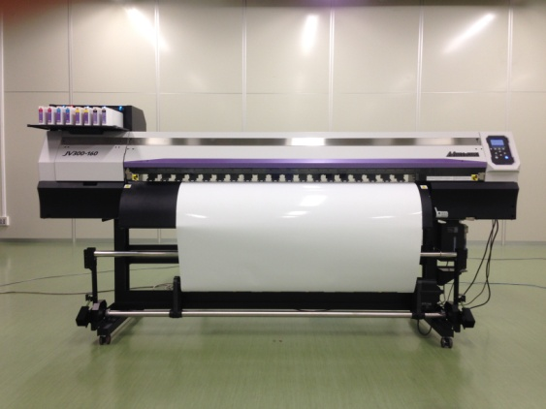
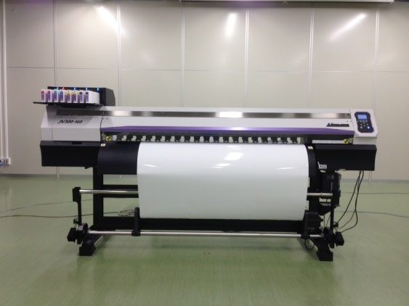
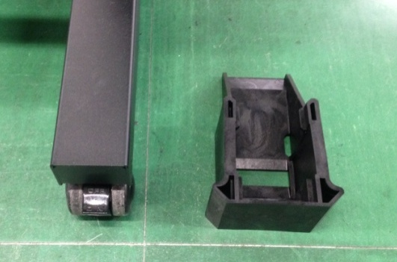
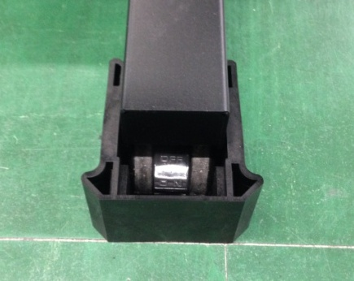
Reduction of the Wobbling of Printer
【Lift up block】
By attaching the Lift Up Block to the casters of machine, the shaking of the
machine while printing is prevented.
w/o Lift up block
w/ Lift up block
Lift up the printer and set Lift up block

Slide 28

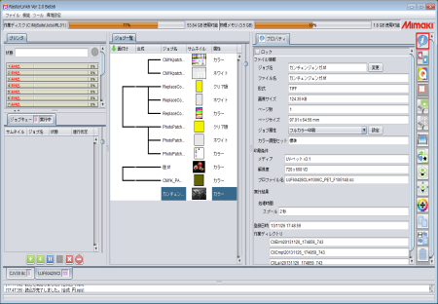












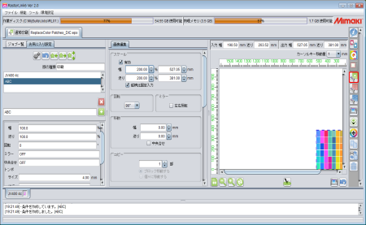
RIP Software - RasterLink6 ①Easy Intuitive Operation
【Intuitive Operation】
【New Advanced Functions】
1
・Batch printing
“Bat best profile when trying to print on
media which has never been used before.
・3-layer printing
Simultaneous 3–layer printing is possible
(Color → White → Color)
・Convenient functions
Estimated Completion Time display
Enhanced layout function
Print Status display
The main information is in one screen. The status of printer, the progress of ripping, the status of job can be checked at a glance. Nesting or composition of job are displayed visually.
The visual icons on the right side of the screen allows for the easy and quick setting of the print condition.
2
3
Frequently used setting can be registered as “My Favorite”.
Up to 30 settings can be registered.
【Web Update function】
The web update is available as well as RasterLinkPro5 which has been well received.
The program update and the profile download can be done through the web easily.

Slide 29
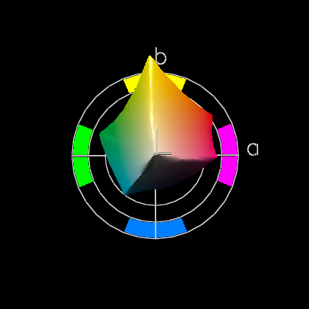
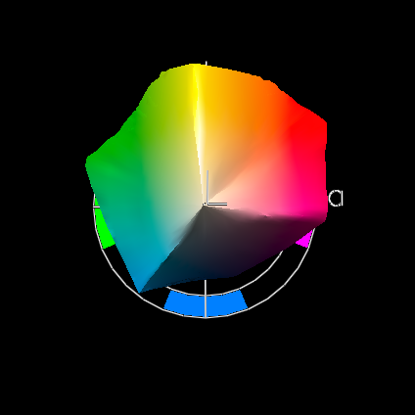
Advanced Features ①Multi-color Matching Profile
Input profile
The Multi-color matching profile (WideMimaki2013forSign) has a wide color
reproduction range of orange area.
WideMimakiCMYK
WideMimaki2013forSign
* Gamut viewer：X-Rite ProfileMaker
“WideMimaki2013forSign” is based on the “WideMimakiCMYK” with the enlargement of general color reproduction domain for a wider color reproduction of orange area.
It generates brilliant color reproduction with higher intensity.
Note）Light colors like skin color or pastel colors will be brighter. It is recommended
to confirm the result with test print as color reproduction will differ from
“WideMimakiCMYK”

Slide 30
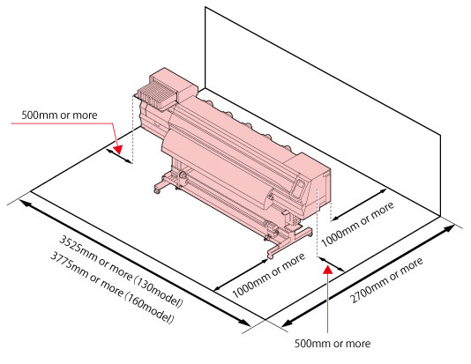
Packing / Installation
【Packing】
Model | Width | Depth | Height | Weight | Manpower for installation | Per Container
JV300-130 | 2,662mm | 750mm | 1,050mm | 222.9kg | 4 people | 20ft:12-unit 40ft:24-unit
JV300-160 | 2,912mm |  |  | 238.5kg
【Installation condition】
●Remarks
1. Do not install on the weak surface floor.
2. Make sure to use in a ventilated environment.
･Environmental temperature: 20℃-30℃
･Quality assurance temperature: 20℃-25℃
･Humidity: 35-65%Rh (no condensation)
･Temperature gradient: ±10℃/h or less
･Dust: Equivalent to office environment
3.Do not install on carpets, etc because those are easy
to be charged, and it can effect the image quality.
4. Ink odor generates. Please use the machine in a
well-ventilated environment.
5. Do not install in the place where using a photograph
fixer or the place with acid steam like acetic acid,
hydrochloric acid.
*Installation space for PC is required separately

Slide 31
Specifications
 | JV300-130 | JV300-160
Print head | On-demand piezo head (staggered dual-head)
Resolution | 360 dpi,540 dpi,720 dpi, 1080 dpi, 1440 dpi
Drop size | Min. 4pl, Max.35pl
Head height | 2.0mm/2.5mm/3.0mm * manual adjustment (+1.0mm or +2.0mm)
Ink type | Eco solvent ink:SS21/BS3/ES3(to be available separately) Sublimation Ink:Sb53
Ink color | SS21:9-color (CMYKLcLmLkOrW), BS3(CMYK), ES3(TBD), Sb53(BlMYKDKLBlLm)
Ink capacity | SS21:440ml cartridge/2L ink pack (W:220ml cartridge only) BS3:600ml ink pack/ 2L ink pack ES3:440ml cartridge (W: 220ml cartridge only) Sb53:440ml cartridge/2L ink pack
Max. printing width | Max.1,361mm (53.5”) | Max.1,610mm (63.3”)
Max. media width | Max.1,371mm (53.9”) | Max.1,620mm (63.7”)
Media thickness | 1.0mm (0.039’”) or less
Roll weight | 40kg (88lb) or less
Outside dimension | 2,541mm(W)x707mm(D)x1,392mm(H) | 2,793mm(W)x707mm(D)x1,392mm(H)
Packing size | 2,662mm(W)x750mm(D)x1,050mm(H) | 2,912mm(W)x750mm(D)x1,050mm(H)
Body weight | 170.6kg (376lb) | 182.4kg (402lb)
Power supply | Single phase (AC100～120V/220～240V ±10％)×2 50/60Hｚ±1Hｚ
Power consumption | (100V) Max 1440W×2 (200V)Max 1920W×2
Applicable standards | VCCI class A / FCC class A / UL60950-1ETL / CE Marking(EMC, Low Voltage and Machinery) CB report / RoHS / REACH・CCC(pending)・Energy Star / RCM

Slide 32
FAQ① Do not disclose this page
# | Questions | Answers
1 | Is the NCU same as that of JV5? | No, it isnt. The NCU of JV5 checks nozzles while scanning while the NCU of JV300 does not.
2 | How the coverage ratio of PANTON color chart measured? | Comparison of the gamut size.
3 | What is the coverage ratio of PATONE color chart when using 4C(CMYK) | 93%
4 | Can MBIS2 be used for JV300? | Yes it can, but the use of MBIS3 is recommended
5 | Can MAPS3 be used for JV33? | No it can’t.
6 | The resolution of 540x1080 is not available? | No it is not. Because even if the image quality is same as 720x720, the scan speed is slower.
7 | How is the outdoor durability of the Orange ink? | Almost same as the Magenta.
8 | Is the ink set of CMYKLcLm available? | No. Because the print speed is same as CMYKLcLmLkOr.
9 | Is the ink set of CMYKOrLkWW available? | No.
10 | Is JV300 compliant with RL5 | No it isn’t.
11 | Does NCU work when using other company’s RIP? | Yes, it does.
12 | Can ink be changed from BS3 to SS21? | No, it can’t.
13 | Can the ink be changed from Sb53 to SS21? | No it cant.
14 | Is JV300 compliant with Ethernet? | No, it isn’t. LAN port is for Event Mail Notification.
15 | What’s the minimum drop size of sublimation ink,Sb53? | At the time of release, the minimum drop size is 8pl. 4pl is under consiideration.
16 | Can MAPS3 be turned off? | No, it can’t.

Slide 33
FAQ② Do not disclose this page
# | Questions | Answers
17 | What is the compliant version of RL6? | Ver.3.0 or later
18 | What is the compliant version of driver? | Ver.4.0 or later
19 | What is the compliant version of F/W? | Ver.1.3 or later
20 | What is the compliant version of MPMⅡ? | Ver.4.00β3 or later
21 | [About the optional Tension bar] Why does the feeding of the media become stable not having the tension bar also at the back-side of printer? | It is ideal to have tension bar also at the back-side, but; ・More effective to have the tension bar at the front ・Censor cannot be incorporated for the feeding.
22 | Does JV300 has common option s with JV33? | No.
23 | How fast does JV300 can print compared to JV33 and TS34. | About 1.7 times faster than JV33. About 1.5 times faster than TS34.
24 | Can drop sizes be selected by user? | No. The best combination of the drop sizes are selected by Mimaki HQ for each ink type and each resolution. The combination is fixed, so user cannot customize .
25 | How much does the drying of ink improve by using the Top Blower? | Of course the drying of the ink is improved, but the main role of the Top Blower is to control the dot sizes.
26 | What is the minimum drop size using BS3? Can 4pl be used for BS3? | The minimum drop size for BS3 is 7pl. For the stable ink ejection, the drop size of 4pl is not used.
27 | When one of the print head broken, can print be continued only using the other print head? | Yes. It will be available in June.
28 | Can ink type be changed? | No it cannot. The ink set can be changed in the cases below. SS21:4C⇔8C Sb53:4C⇔6C
29 | What is the height of the JV300 printer with the MBIS attached? | 1,845mm

Slide 34
Revision History Do not disclose this page
Ver | Date | Content | Drafter
1.0 | 4/18 | Preliminary version issued. | Global Marketing Dept. Ryosuke Nakayama
1.1 | 4/22 | P7 The resolution of the draft mode of PVC(4C) is modified. | Global Marketing Dept. Ryosuke Nakayama
0.1－0.7 |  | Preliminary version issued. | Global Marketing Dept. Ryosuke Nakayama
0.8 | 5/8 | Spot color printing pages are deleted. | Global Marketing Dept. Ryosuke Nakayama
1.0 | 5/14 | Ver 1.0 issued. | Global Marketing Dept. Ryosuke Nakayama
1.1 | 5/16 | P.30 Specifications ①Outside dimension②Power Consumption is corrected. | Global Marketing Dept. Tomomi Tokuda
1.11 | 5/26 | P13 The density of white is changed. P19 NCU page is changed. P24 Color LCD size is corrected. | Global Marketing Dept. Ryosuke Nakayama
1.12 | 5/28 | P7-10 Resolutions are changed. P16 The explanation of Top Blower is changed. P23 The photo of MBIS3 is changed P30 Total weight is corrected. | Global Marketing Dept. Ryosuke Nakayama
1.13 | 6/3 | P3 Names of options are changed. | GM Dept. Tomomi Tokuda
1.2 | 6/5 | Ver 1.2 issued. | Global Marketing Dept. Ryosuke Nakayama
1.3 | 6/20 | P3/P4/P23 MBISⅢ→MBIS3 P19 NCU work flow: Cleaning → Cleaning is done automatically P21 Event Mail Notification: Available in October P26 Multi-Language Display: | Global Marketing Dept. Ryosuke Nakayama

